Slide 1
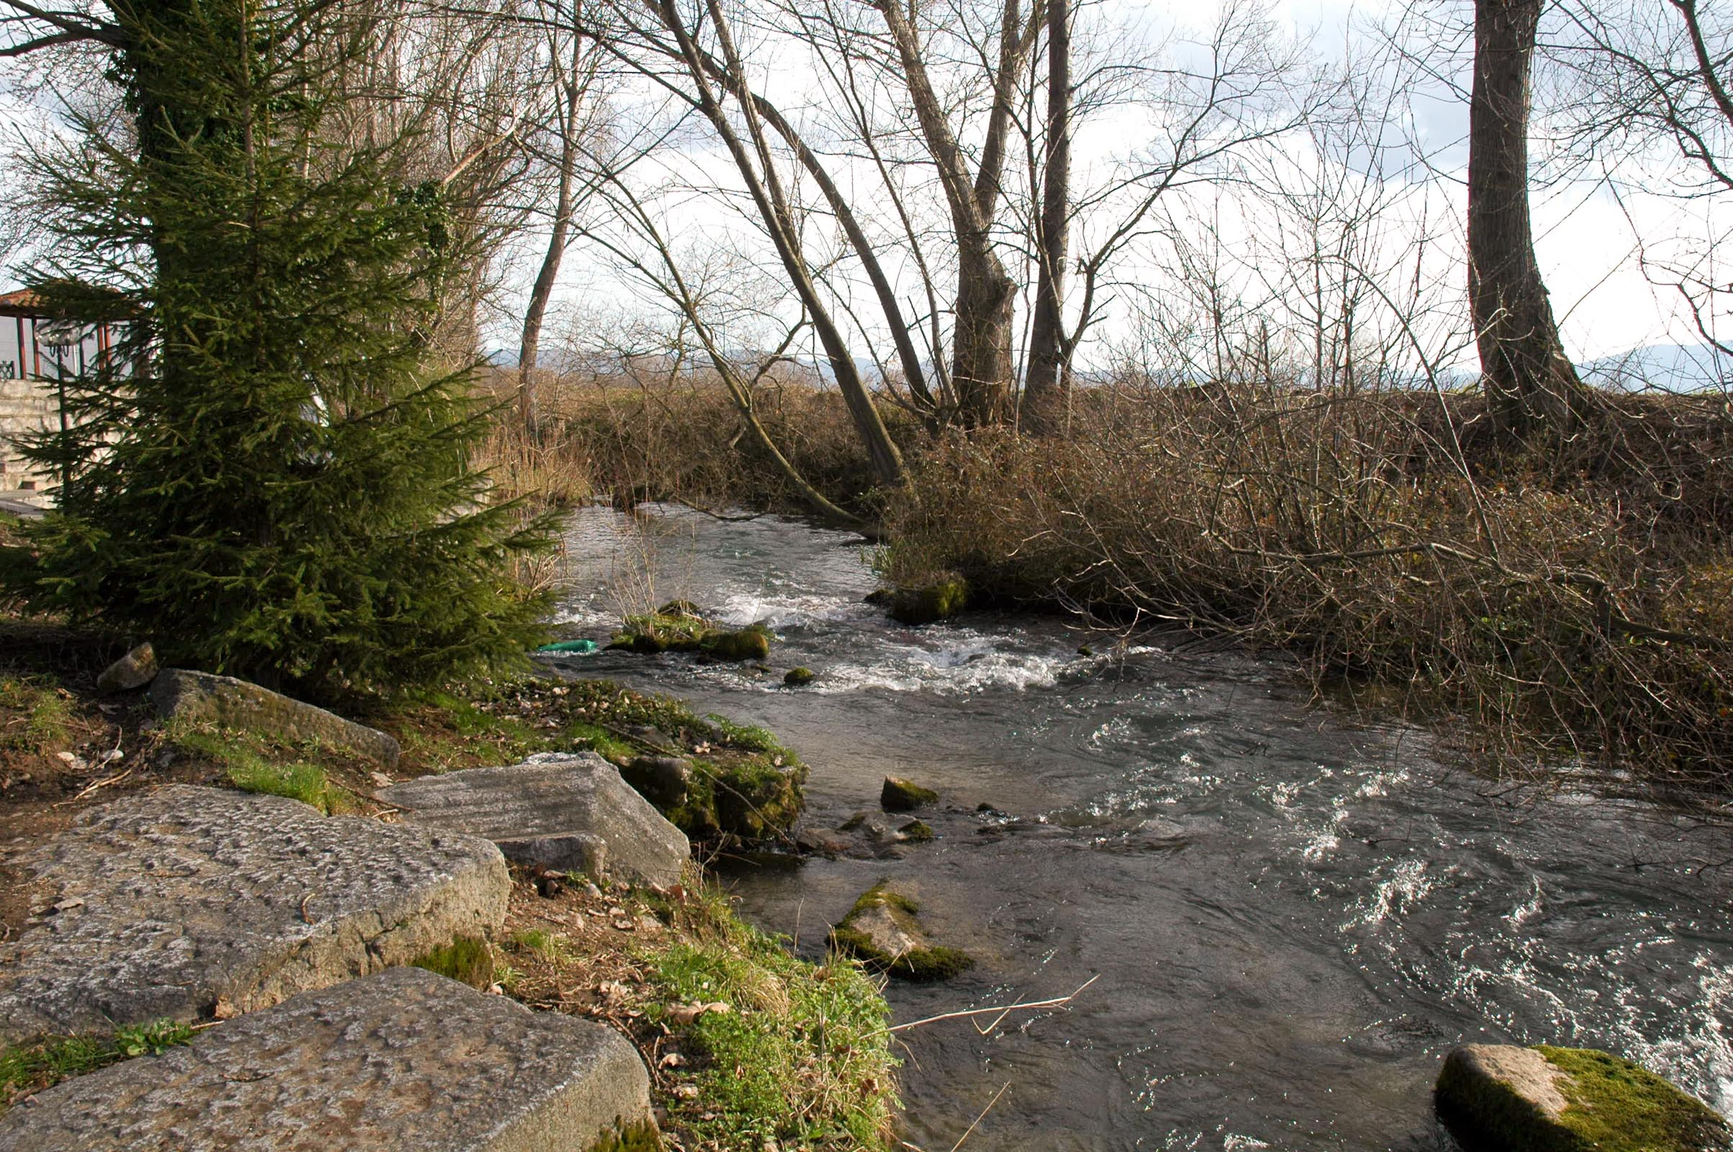
Likely spot of where Paul and Timothy began evangelizing to found the church in Philippi.
image ©2012 Todd Bolen / BiblePlaces.com

Slide 2
AD45 AD50 AD55 AD60 AD65
A
B
C
D
A. AD49-52: 2nd Missionary Journey; Paul met Timothy before founding the church at Philippi.
B. AD53-57: 3rd Missionary Journey; Paul and Timothy revisited the Philippian church.
C. AD57-60: Paul was imprisoned in Caesarea.
D. AD60-62: Paul was imprisoned in Rome.

Slide 3
Cultic Legalists
use
to pressure
False Gospel
Philippians
to act in the flesh
seek to earn righteousness

Slide 4
Cultic Legalists
Paul & Timothy
use
use
to pressure
to exhort
False Gospel
True Gospel
Philippians
to act in the flesh
to act on revelation
seek to earn righteousness
trust in imputed righteousness

Slide 5
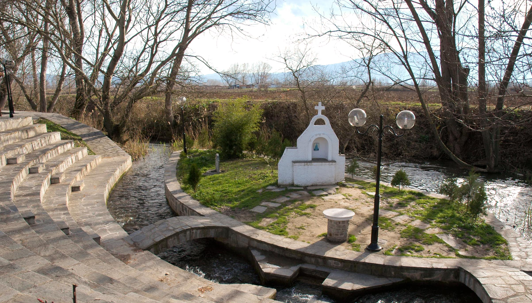
Philippians 1.1-2 NET: From Paul and Timothy, slaves of Christ Jesus, to all the saints in Christ Jesus who are in Philippi, with the overseers and deacons. Grace and peace to you from God our Father and the Lord Jesus Christ!
image ©2012 Todd Bolen / BiblePlaces.com

Slide 6
Philippians 1.1-2 NET: From Paul and Timothy, slaves of Christ Jesus, to all the saints in Christ Jesus who are in Philippi, with the overseers and deacons. Grace and peace to you from God our Father and the Lord Jesus Christ!
image ©2012 Todd Bolen / BiblePlaces.com

Slide 7
Philippians 1.1-2 NET: From Paul and Timothy, slaves of Christ Jesus, to all the saints in Christ Jesus who are in Philippi, with the overseers and deacons. Grace and peace to you from God our Father and the Lord Jesus Christ!
image ©2012 Todd Bolen / BiblePlaces.com

Slide 8
Philippians 1.1-2 NET: From Paul and Timothy, slaves of Christ Jesus, to all the saints in Christ Jesus who are in Philippi, with the overseers and deacons. Grace and peace to you from God our Father and the Lord Jesus Christ!
image ©2012 Todd Bolen / BiblePlaces.com

Slide 9
Philippians 1.1-2 NET: From Paul and Timothy, slaves of Christ Jesus, to all the saints in Christ Jesus who are in Philippi, with the overseers and deacons. Grace and peace to you from God our Father and the Lord Jesus Christ!
image ©2012 Todd Bolen / BiblePlaces.com

Slide 10
Philippians 1.1-2 NET: From Paul and Timothy, slaves of Christ Jesus, to all the saints in Christ Jesus who are in Philippi, with the overseers and deacons. Grace and peace to you from God our Father and the Lord Jesus Christ!
Greek “ἅγιος” = Latin “sanctus” = English “saint”
= “holy one”
image ©2012 Todd Bolen / BiblePlaces.com

Slide 11
Philippians 1.1-2 NET: From Paul and Timothy, slaves of Christ Jesus, to all the saints in Christ Jesus who are in Philippi, with the overseers and deacons. Grace and peace to you from God our Father and the Lord Jesus Christ!
Believers are…
 justified = declared righteous in God’s sight
 sanctified = separated out for God’s purposes
image ©2012 Todd Bolen / BiblePlaces.com

Slide 12
Philippians 1.1-2 NET: From Paul and Timothy, slaves of Christ Jesus, to all the saints in Christ Jesus who are in Philippi, with the overseers and deacons. Grace and peace to you from God our Father and the Lord Jesus Christ!
image ©2012 Todd Bolen / BiblePlaces.com

Slide 13
Philippians 1.1-2 NET: From Paul and Timothy, slaves of Christ Jesus, to all the saints in Christ Jesus who are in Philippi, with the overseers and deacons. Grace and peace to you from God our Father and the Lord Jesus Christ!
slaves: focused on serving Christ and his gospel mission regardless of what their circumstances are
saints: assured they are loved by God and righteous before God regardless of what their circumstances are

Slide 14
Philippians 1.1-2 NET: From Paul and Timothy, slaves of Christ Jesus, to all the saints in Christ Jesus who are in Philippi, with the overseers and deacons. Grace and peace to you from God our Father and the Lord Jesus Christ!
image ©2012 Todd Bolen / BiblePlaces.com

Slide 15
Philippians 1.1-2 NET: From Paul and Timothy, slaves of Christ Jesus, to all the saints in Christ Jesus who are in Philippi, with the overseers and deacons. Grace and peace to you from God our Father and the Lord Jesus Christ!
image ©2012 Todd Bolen / BiblePlaces.com

Slide 16
1. Jesus is the Messiah-savior
image ©2012 Todd Bolen / BiblePlaces.com

Slide 17
1. Jesus is the Messiah-savior
2. Our identity is found in Christ
image ©2012 Todd Bolen / BiblePlaces.com

Slide 18
1. Jesus is the Messiah-savior
2. Our identity is found in Christ
3. Believers are secure in position as “holy ones”
image ©2012 Todd Bolen / BiblePlaces.com

Slide 19
1. Jesus is the Messiah-savior
2. Our identity is found in Christ
3. Believers are secure in position as “holy ones”
4. Believers should grow to be slaves for Christ
image ©2012 Todd Bolen / BiblePlaces.com

Slide 20
1. Jesus is the Messiah-savior
2. Our identity is found in Christ
3. Believers are secure in position as “holy ones”
4. Believers should grow to be slaves for Christ
5. We should have unity to defend sound doctrine
image ©2012 Todd Bolen / BiblePlaces.com

